Slide 1
ML: Stroke Prediction
Machine Learning
Team Members:
Kuanysh Tokayev
Angsar Aidarbek
Alisher Amantay
Olzhas Jalmukhambetov
Temirlan Zarymkanov

Slide 2
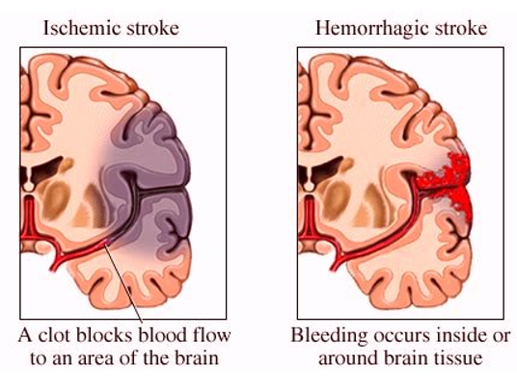
What is stroke?
A stroke is a medical condition of brain cells death caused by the poor blood flow to the brain. There are two main types of stroke: ischemic, due to lack of blood flow, and hemorrhagic, due to bleeding. Symptoms are inability to move or feel, loss of vision, problems with understanding and speaking.

Slide 3
Why is it important?
Stroke is one of the leading causes of death worldwide
Death rates due to stroke are growing

Slide 4
Motivation
An intensive care unit (ICU) is a special department of a health care facility that provides intensive care medicine.
Placing patients at ICU significantly decreases their risks of death and poor outcome.
Places in ICU are limited
Prioritize ICU admission in favor of severe patients
Determining which patients are at the highest risk is not a trivial task
ML tool to support decisions

Slide 5
Dataset
150 entries from patients diagnosed with stroke
Target is whether the patient passed away. 0 - is alive, 1 - died
A well-balanced target: 40% of patients died
Made a 80-20 train-test split, CV for validation
26 features in the final dataset
Categories of features:
Stroke characterization (type, area)
Disease history (diabetes, hypertension, cardiovascular diseases)
Lifestyle (age, gender)
Measurements (Glasgow Coma Scale, blood pressure, heart rate)
Feature types:
Binary, ordinal, discrete and continuous
Tried to give multiclass categorical features ordinality

Slide 6
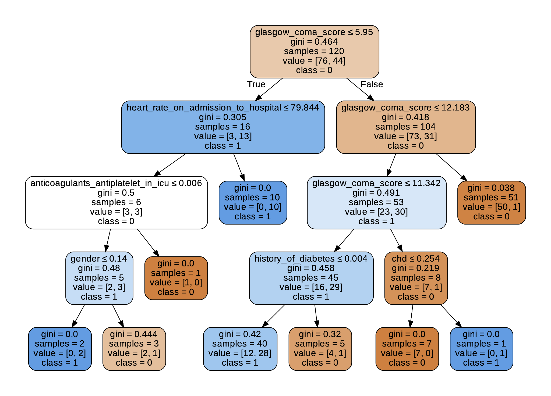
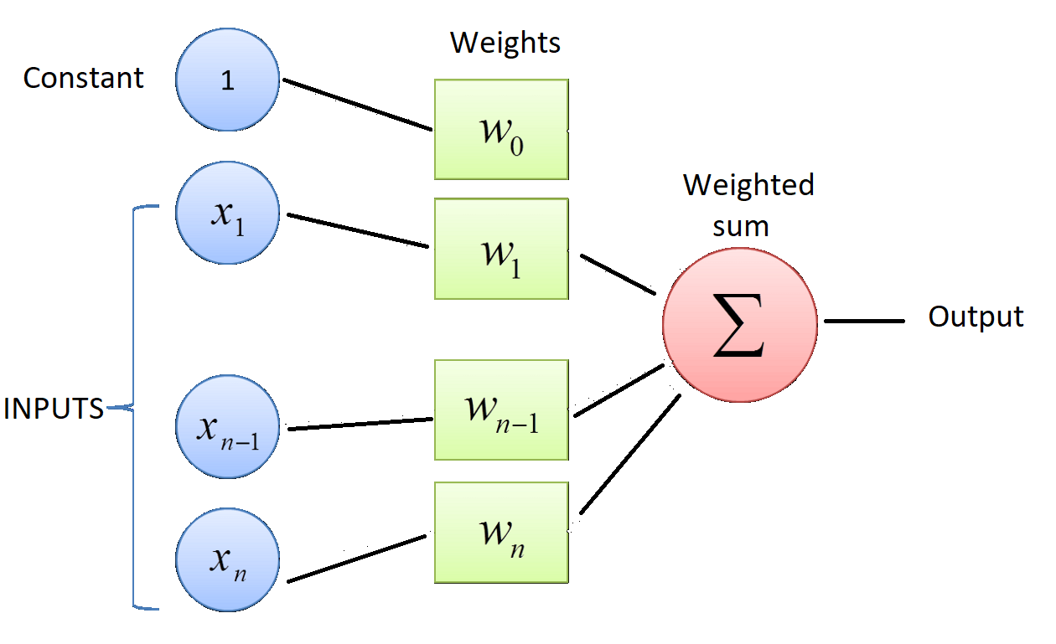
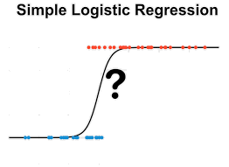
Algorithms
Decision tree - the goal is to create a model that predicts the value of a target variable by learning simple decision rules inferred from the data features.
Perceptron is a linear binary classifier, consisting of several layers. Inputs are multiplied by weights to calculate the weighted sum and define an input.
Logistic regression is a process of modeling the probability of a discrete outcome given an input variable.

Slide 7
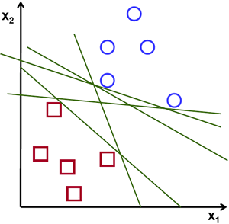
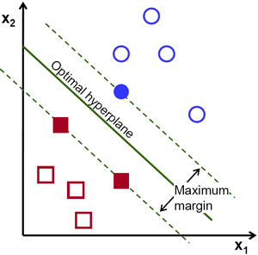
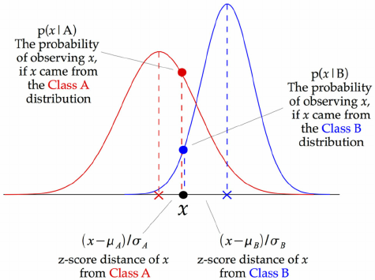
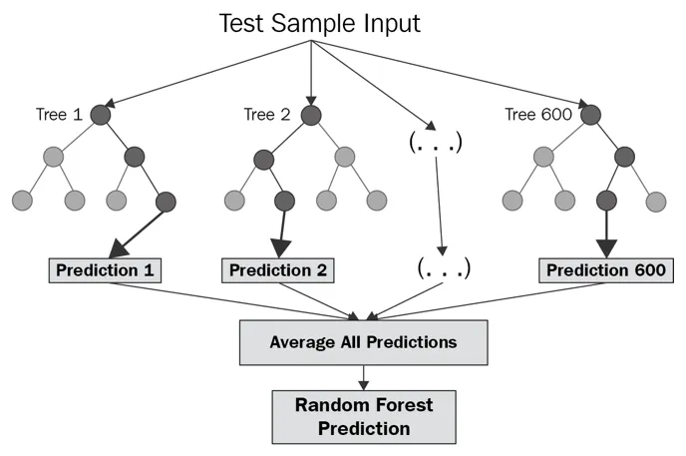
Algorithms
Support Vector Machine - objective of the support vector machine algorithm is to find a hyperplane in an N-dimensional space(N — the number of features) that distinctly classifies the data points.
Gaussian Naive Bayes Classifier is not a classification, but a generative model. At every data point, the z-score distance between that point and each class-mean is calculated, namely the distance from the class mean divided by the standard deviation of that class
Random forest is a classification algorithm consisting of many decisions trees. It uses bagging and feature randomness when building each individual tree to try to create an uncorrelated forest of trees whose prediction by committee is more accurate than that of any individual tree.

Slide 8
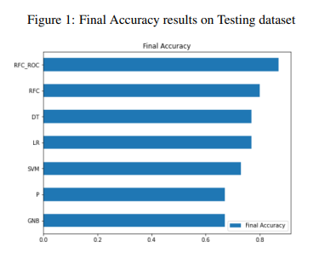
Final Accuracy Results
LR
SVM
C-parameter: 1.0
Solver:: lbfgs
penalty: l2
C-parameter: 421.6
Gamma: 4.8e-0.6
GNB
P
var_smoothing parameter: 0.001
alpha parameter: 0.0001
max_iter: 2.78
DT
RFC
max_depth: 4
ccp_alpha: 0.005
splitter: alpha
ROC area: 0.96
n_estimators:16
max_depth: 4

Slide 9
Top 3 Algorithms
77%
87%
77%
DT
RFC_ROC
LR
F1 score : 0.82
Accuracy on CV: 0.88
Precision: 0.9
F1 score : 0.72
Accuracy on CV: 0.76
Precision: 0.69
F1 score : 0.70
Accuracy on CV: 0.78
Precision: 0.73

Slide 10
Feature Importance
GCS
Area of Stroke
Glasgow Coma Score
Left hemisphere: 2, right hemisphere: 1, other: 0
History of Diabetes
Most Important Features
Cerebral Edema on Admission
Whether had diabetes mellitus
Was there cerebral edema
Stroke Type
Internal Pressure
0: ischemic,
1: hemorrhagic, mixed
Arterial hypertension and mean arterial pressure

Slide 11
Final thoughts
Insights: GCS, Cerebral Edema on Admission
Other solutions and Limitations: size and consistency of dataset, high cross parallel interference
Future works: increase dataset, add more features, add new algorithms

Slide 12
Thank you for your attention!

